Slide 1
JavaScript development frameworks
Promises and file management
TypeScript

Slide 2
Course objectives
Introduction to JavaScript. Overview
Basic http handling
Building a web server with NodeJS
NodeJS. Request and response, HTML templates, JSON data
NodeJS routing
ExpressJS
NPM, build tools
File management. Promises
Introduction to TypeScript
Introduction to Angular 2
Angular modules, applications, components
Angular services
Angular templates
Observables in Angular
Routing in Angular

Slide 3
Learning objectives
Learn how to read and write to files in the filesystem using NodeJS
Callbacks and Promises
Typescript

Slide 4
Read and write to filesystem
NodeJS offers a library for file management called `fs` (short for fileystem)
This library is a wrapper around standard POSIX (Portable Operating System Interface)
POSIX is an IEEE standard for operating systems to offer an unified API

Slide 5
Read and write to filesystem
To use `fs`, simply require(‘fs’) in the application
FS offers async and sync methods
By default all methods are async
To use synchronous methods, use the method name should end with Sync
This is not a standard to use sync methods, this is just how the methods are named

Slide 6
Read and write to filesystem
fs.readFile(‘path/to/file’, options, callback);
fs.readFile(‘path/to/file’, callback);
fs.readFileSync(‘path/to/file’[, options]); // returns file contents
var fs = require(’fs’);
fs.readFile(‘path/to/file’, (err, data)=> {
if(err) console.error(err);
console.log(data);
})

Slide 7
Read and write to filesystem
fs.writeFile(‘path/to/file’, content, options, callback);
fs.writeFile(‘path/to/file’, content, callback);
fs.writeFileSync(‘path/to/file’[, options]); // returns if the contents are saved
var fs = require(’fs’);
fs.writeFile(‘path/to/file’, ‘Hello everyone’, (err, data)=> {
if(err) console.error(err);
console.log(’Data is saved’);
})

Slide 8
Read and write to filesystem
Check out the NodeJS documentation for the FileSystem module

Slide 9
Promises
a Promise is an object used for asynchronous computations
a Promise represents a value that is available now, in the future or never
Promises were created as a response to using callbacks
The problem was when using nested callbacks, you have `unreadable` code
Promises fixed that

Slide 10
Promises
Promise can have 2 states
Resolve – if the task was resolved
Reject – if the task was rejected, or failed
Try to chain promises
Or simply put, don’t forget to return the promise once you’re done with it
Promise requires two parameters: resolve, reject
Methods that will be called one the promise finishes
To do something one the promise finishes, use the .then() method

Slide 11
Promises

Slide 12
Promises - example
console.log(‘Promise started’);
let myPromise = new Promise(function(resolve, reject) {
console.log(‘Async code started’);
setTimeout(function(){
// resolve the promise
resolve(‘Here is the response’);
}, Math.random()*2000 + 1000);
});
console.log(’Promise finished’);
myPromise.then((responseFromPromise) => {
console.log(‘Response’ + responseFromPromise);
});
console.log(’After Promise call’);

Slide 13
Promises
This is used in Angular 1 modules, mainly for http requests because they are async requests
$http.get(‘/get/news/page’) .then((response)=> console.log(response.news) });
Check out Kris Kowal’s module for promises, called Q
Q was heavily used in Angular 1

Slide 14
TypeScript
TypeScript is a typed superset of JavaScript that compiles to plain JavaScript
It uses the latest features of JavaScript, including ES6
Check out the documentation for TypeScript for more features that it offers
Important features
Import/export
Using classes
Inheritance

Slide 15
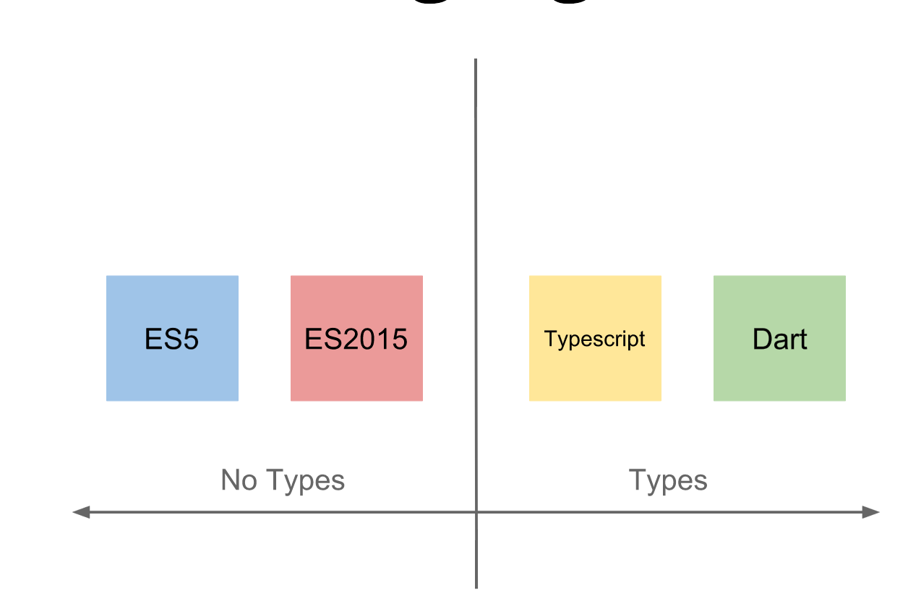
TypeScript

Slide 16
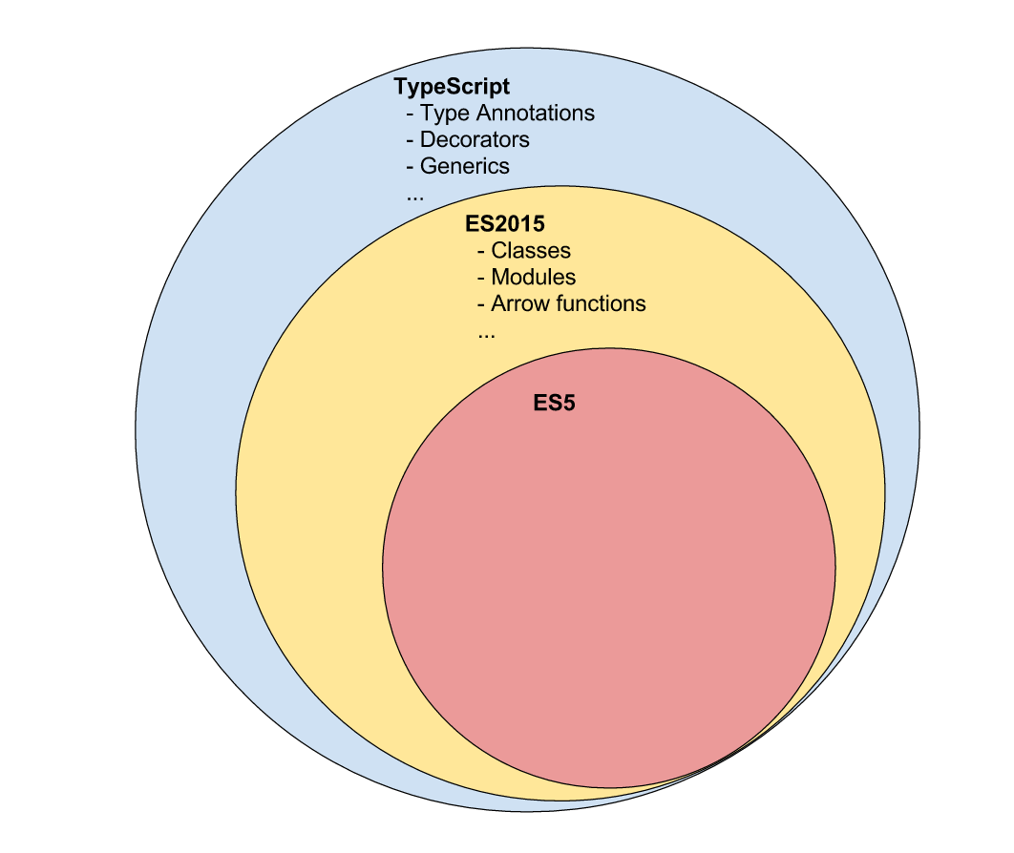
TypeScript

Slide 17
Demo

Slide 18
Tasks

